Slide 2

^{From Slow to Pro}
Accelerating Kubernetes Native Development with Kind & DevSpace

Slide 3
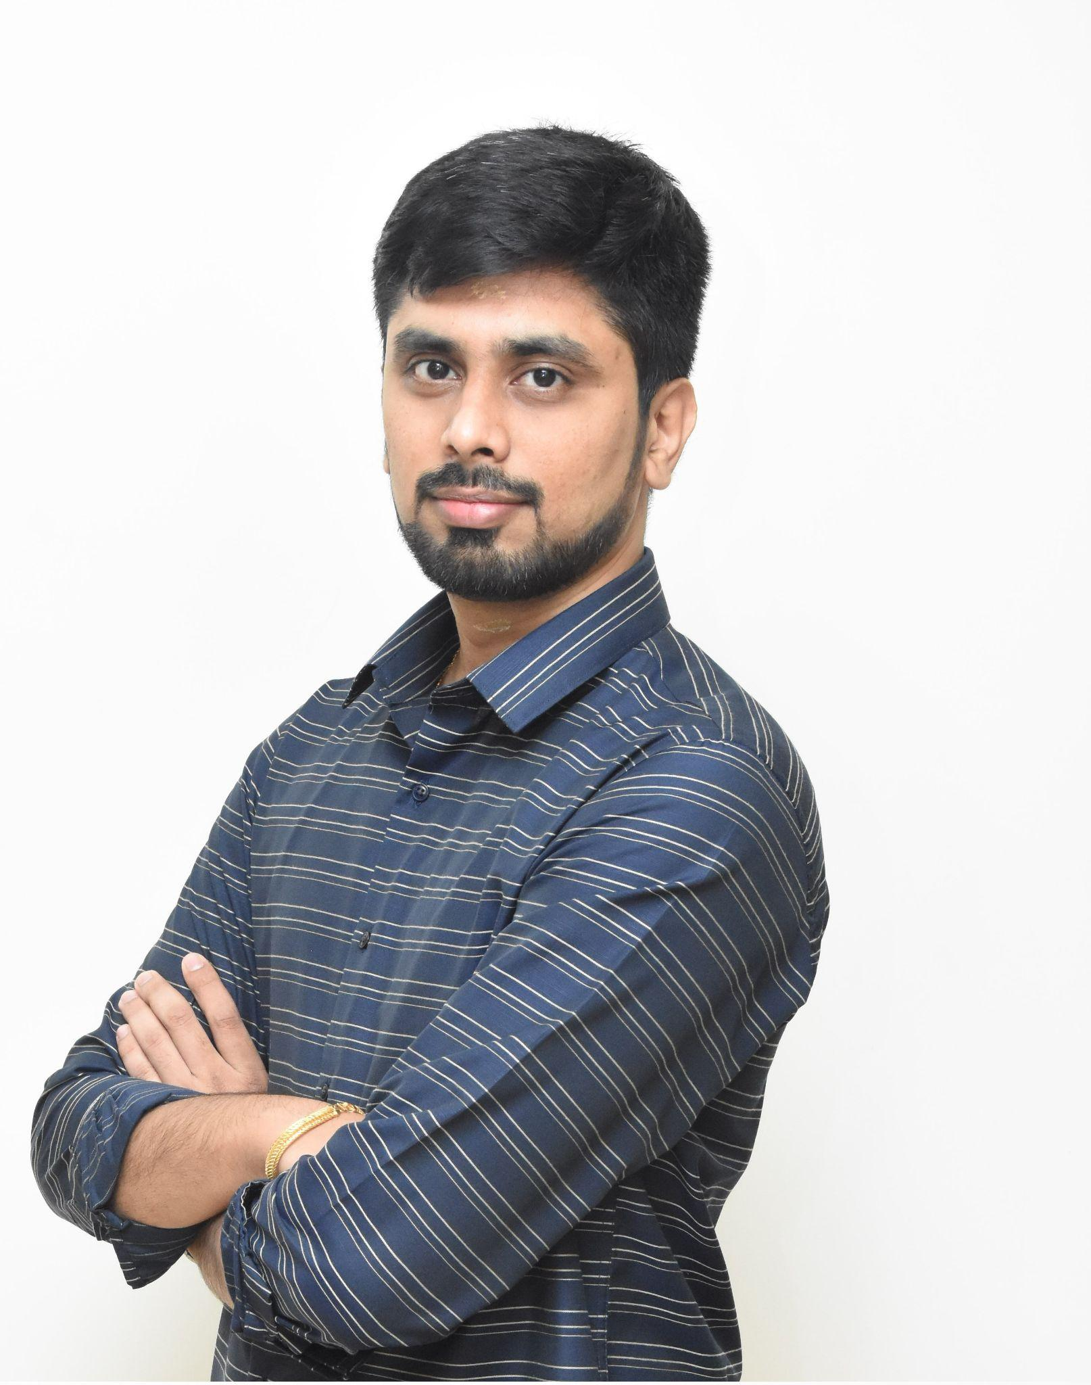
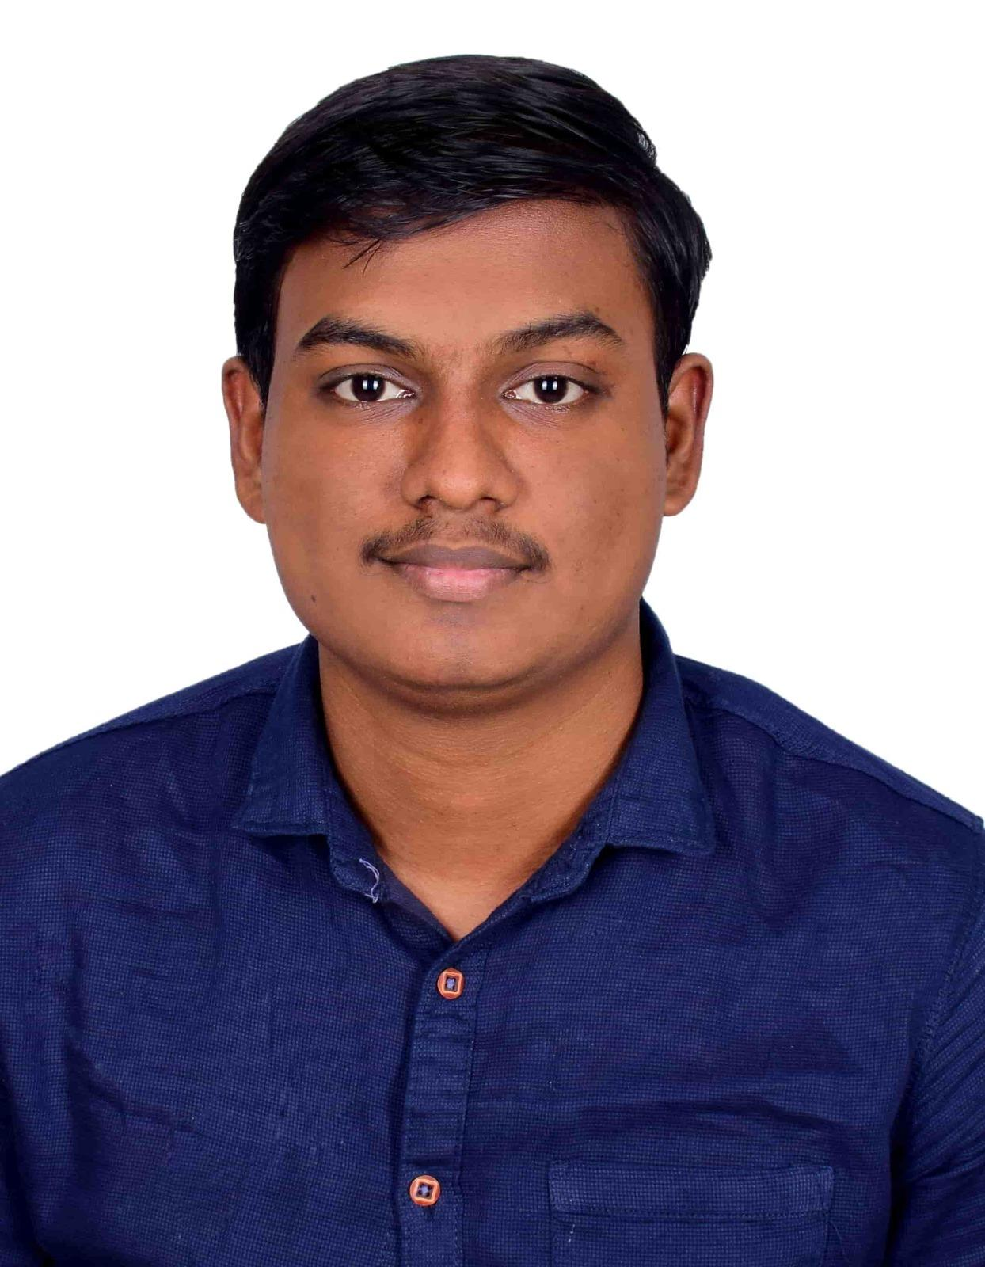
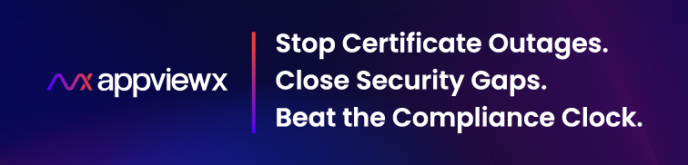
About Us
Raghu Chandrasekaran
Solutions Architect
Naveenkumar Kumanan
Software Development Engineer

Slide 4

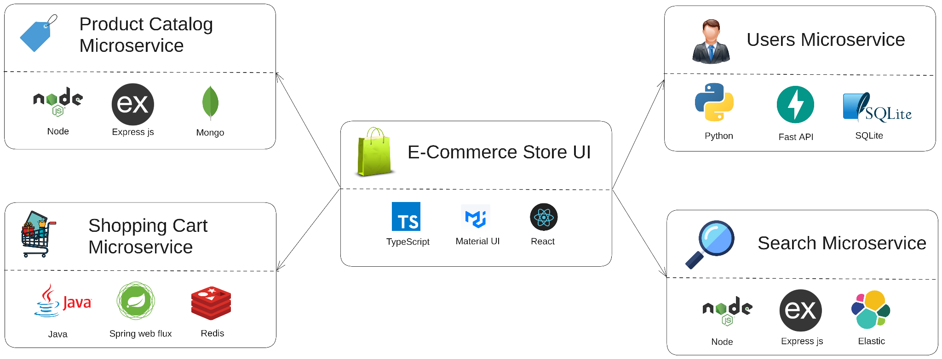
Meet Aditya: Week 1 at Clusterly
Aditya’s first week at Clusterly:
• Clusterly an e-commerce giant has polyglot microservices
• His first assignment - Fix a simple bug
Architecture inspired by @venkataravuri's ecommerce-microservices-sample. Forked and customized for the fictitious Clusterly e-commerce app.

Slide 5
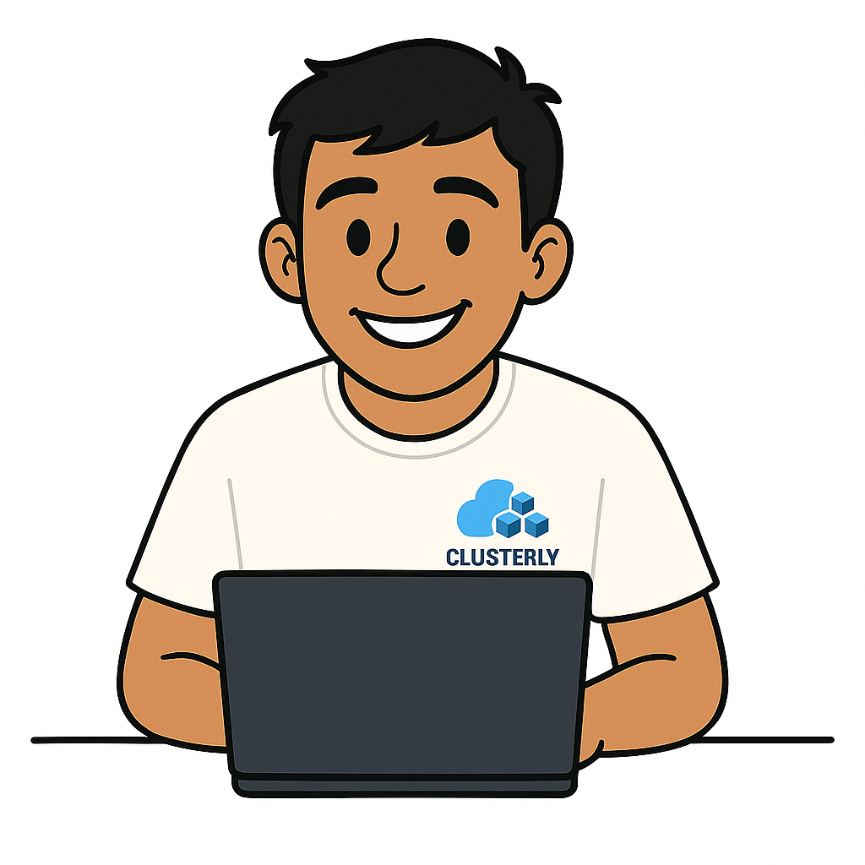

Aditya’s Journey
Excited to build the Cart backend! Let’s ship innovation 😄
Cart Microservice

Slide 6

Aditya’s Journey
Redis Dependency? No worries, spinning it up 😌
Cart Microservice
Redis

Slide 7

Aditya’s Journey
Cart API up and running - Next Store UI 🙂
Cart Microservice
Redis
Store UI

Slide 8
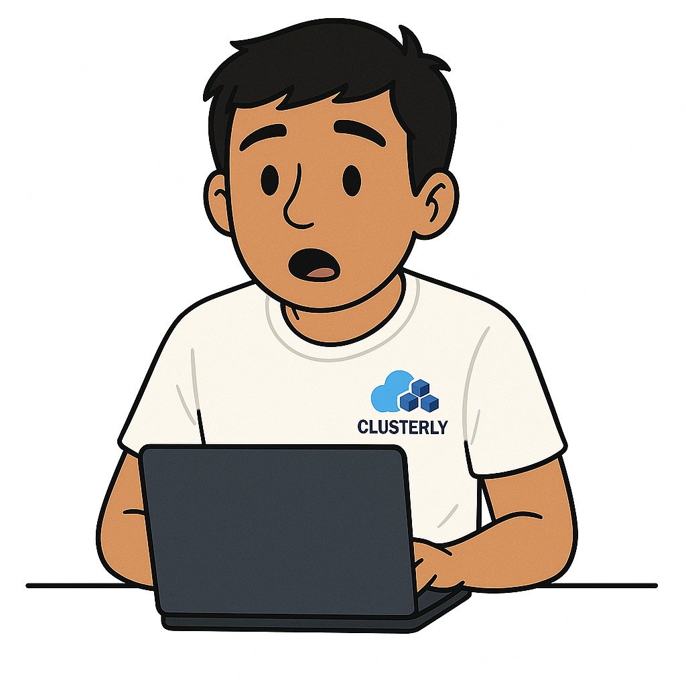

Aditya’s Journey
Wait… Store UI needs Product service for real items? 🤨
Cart Microservice
Redis
Store UI
Product Microservice

Slide 9

Aditya’s Journey
Oh great, Product needs Mongo running too 😤
Cart Microservice
Redis
Store UI
Mongo DB
Product Microservice

Slide 10


Aditya’s Journey
Still error!! Let me check logs… what even is this?! 😵‍💫

Slide 11

Aditya’s Journey
README is outdated, senior's busy — I’m stuck 😓

Slide 12
Aditya’s Journey
What do I do now? Brain officially fried 😫
Cart Microservice
Redis
Store UI
Mongo DB
Product Microservice

Slide 13


Share Your Pain: Tell Us About Your Feedback Loop
To see how widespread Aditya’s challenge is, we’d like to hear from you. Please take out your phone and join a quick poll.
Open a browser and go to menti.com, then enter the code
4807 2855
(or)
Scan the QR code on the right

Slide 14
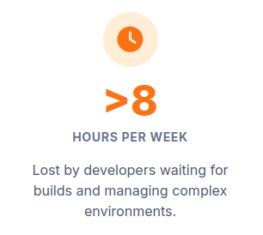
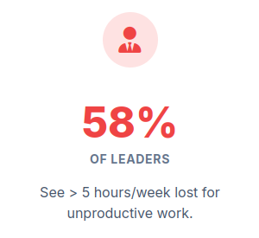
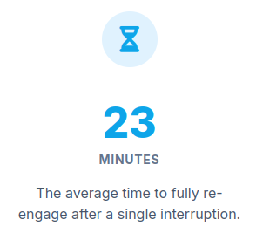
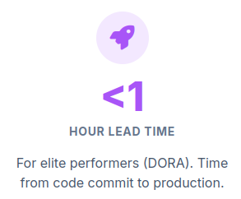
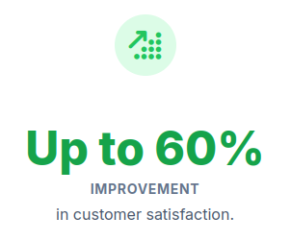
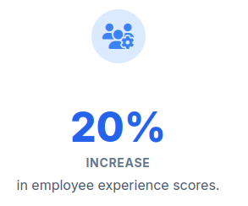
Why Aditya's Wait Matters: The Business Cost of a Slow Loop
Data Sources: [1], [2] [3], [4]

Slide 15
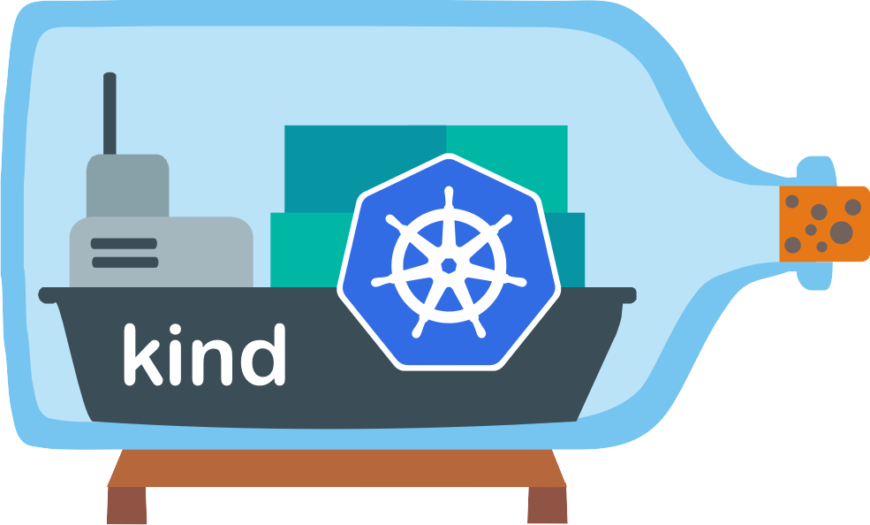

The Accelerator Toolkit
“There’s a better way to work.” - Aditya
Challenges
Realistic local clusters are a hassle
Slow edit-build-push-deploy loop
Ephemeral test environments are expensive
Debugging inside pods is clunky
With Kind, Get a realistic environment in seconds
With DevSpace,
See code changes instantly.
Automate your entire workflow
Develop anywhere with a consistent process.

Slide 16
The ‘Pro’ Setup
Live Demo
We’ll create a K8s Cluster using Kind and use DevSpace to debug and fix Aditya’s issue

Slide 17
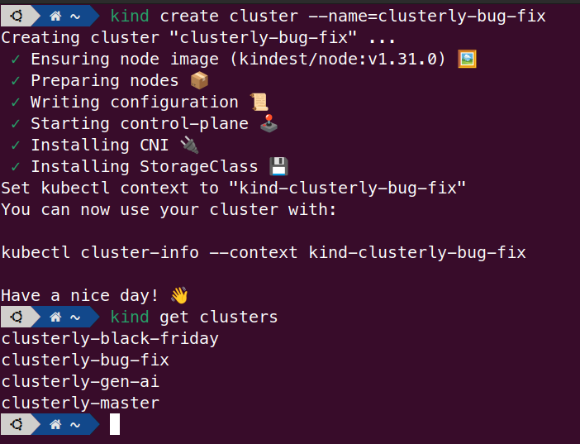
Under the Hood
kind: Cluster
apiVersion: kind.x-k8s.io/v1alpha4
nodes:
- role: control-plane
- role: control-plane
- role: worker
- role: worker
- role: worker
extraPortMappings:
- containerPort: 30080
hostPort: 80
protocol: TCP
- containerPort: 30443
hostPort: 443
protocol: TCP
Ephemeral cluster per branch / task • Zero config drift; always start clean • Auto-create & tear down for every branch/feature
One-YAML multi-node cluster • Spin up control-plane + workers locally • Safely test HA, network policies & failures
Service virtualization • Mock dependent microservices • Focus on a single component, not the whole stack

Slide 18
Under the Hood
Rapid inner-loop development • Hot-reload your containerized app in seconds
• Sync local files directly into running pods
• Debug services effortlessly — no more grepping logs
Teams need control without complexity
• Develop seamlessly on any K8s cluster — local or remote — as if it's right on your laptop
• Customize dev workflows with simple YAML tweaks beyond the default dev, build, and deploy flows
Developer first design from the start
• Supports dev with guided questions and reusable templates for quick onboarding
• Lightweight CLI integrates cleanly with kubectl workflows; No agents or daemons — zero footprint on your cluster
• DevSpace UI lets you replay or inspect the custom commands
DevSpace is like kubectl on steroids

Slide 19
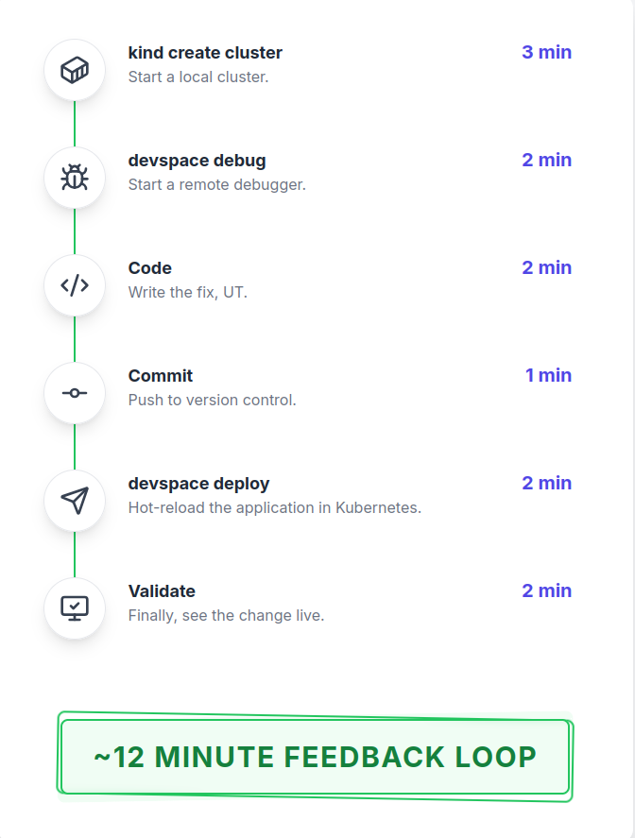
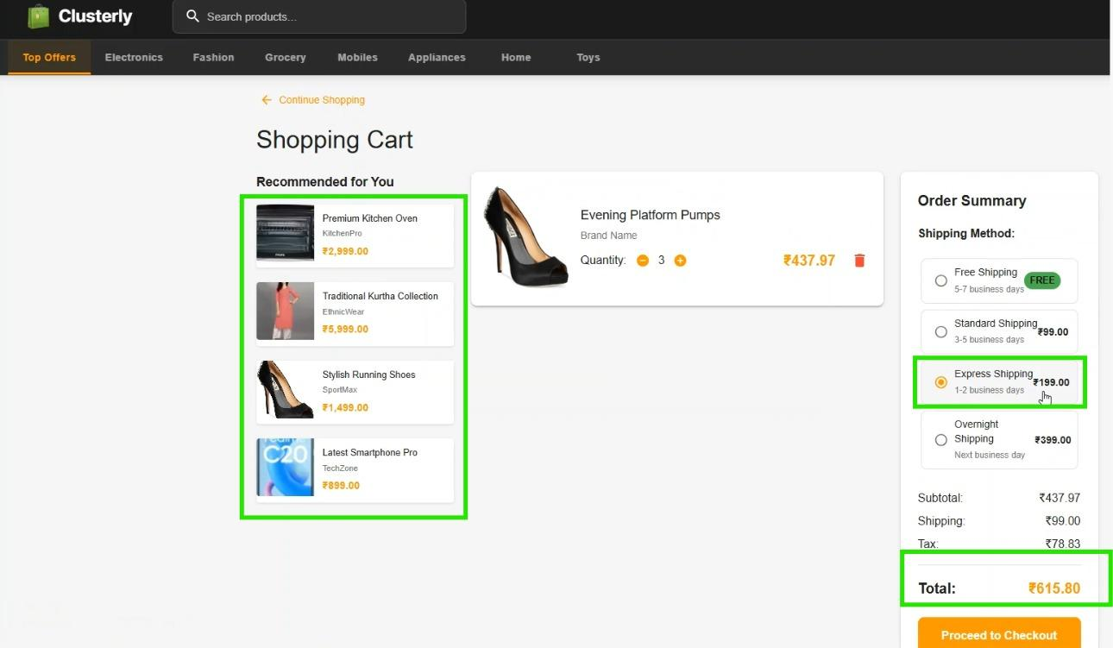
The Pro World: 12 Minute Feedback Loop
Good tools don't just make you faster;
they let you stay in the flow - Aditya

Slide 20
Key Learnings & Takeaways
Our Learnings
Onboarding time slashed: 1 day ➜ 1 hour
Dev feedback loop accelerated: 60 min ➜ 5 min
Ship a wrapper script that bundles all tooling, so you can swap tools or tweak the flow without disrupting devs
Instant code comprehension - even for unfamiliar repos
Live, in-IDE debugging in production-like clusters
Takeaways
Shift Left: It's About Fidelity, Not Just Speed
Adapt the Tools to fix Your Bottleneck

Slide 21
References
[1] DevOps survey showing 69 % of developers lose ≥ 8 hours per week - devops.com
[2] Cortex report indicating 58 % of leaders see > 5 hours/week lost - cortex.io
[3] Article outlining DORA metrics and elite vs low performance benchmarks - datadoghq.com
[4] Report showing improvements in customer satisfaction and employee experience from boosting developer productivity - mckinsey.com

Slide 22

Demo Code
https://github.com/RaghuChandrasekaran/kubecon-india-2025/
Get the Slides & Demo Code

Slide 23


Thank you, Let’s Connect
Raghu Chandrasekaran
Naveenkumar Kumanan

